Slide 1
Serverless Single Page Apps on AWS
What we've learned so far.

Slide 2
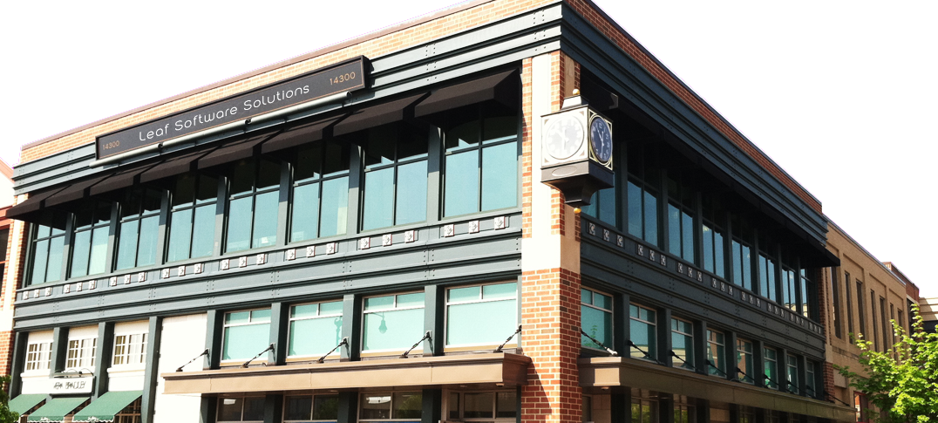

Leaf Software Solutions
Chris Chalfant & Andrew Kaczorek
Cloud Services and Rapid Development Team

Slide 3
Topics
Why Serverless?
Architecture
Lessons Learned

Slide 4
What do we mean by Serverless?
An architecture, based on Functions as a Service, along with SaaS datastore.
We don’t run/maintain servers.
It’s a framework, https://serverless.com, used to configure cloud resources to deploy Functions.

Slide 5
Our Client
Ascend Indiana
http://ascendindiana.com
The Ascend Network blends algorithmic connections and human expertise to match Indiana college graduates to Indiana companies

Slide 6
Why Serverless?
For small scale web app/API, nearly free hosting costs
For large scale, two orders of magnitude cost savings
Much less scaling/capacity planning
Pre-prod env costs ~$85/month ($50 RDS, $30 NAT)

Slide 7
Architecture
S3/CloudFront for static content and React SPA
AWS Lambda and Amazon API Gateway for REST API
S3-triggered Lambda Functions for media manipulation
Scheduled Lambda Functions for backend workers
Amazon RDS (MySQL) for persistence
Python API uses SqlAlchemy ORM
Auth0 for Authentication
CloudWatch Logs/Metrics for monitoring

Slide 8
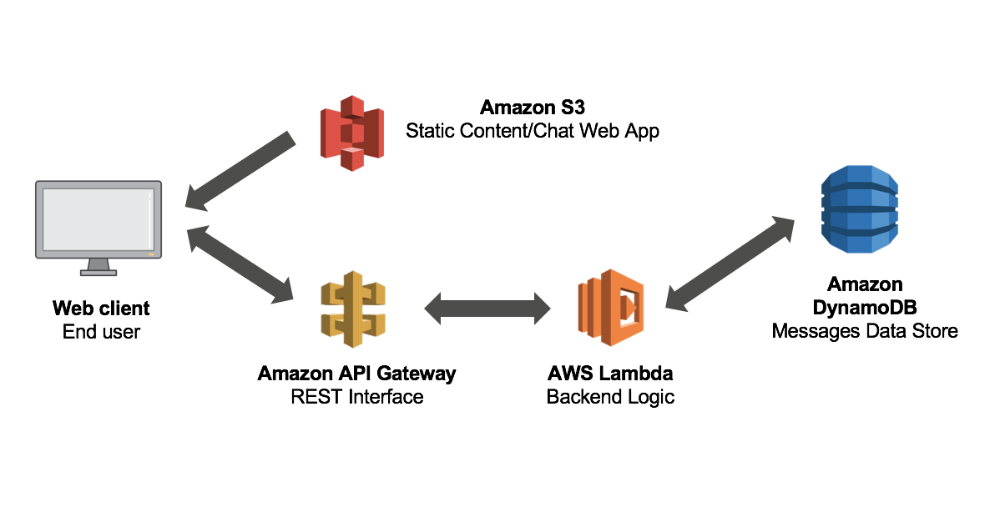

Slide 9
Ok, so not entirely serverless...
DB is in a private VPC and not accessible directly from internet.
We have a t2.micro for SSH tunnel. Tunnel used for DB connectivity to dev workstations.
Could solve this with migration Lambdas (Serverless plugin?)

Slide 10
Lessons Learned: Framework
There are many FaaS frameworks, but this is the most mature. Zappa is another we would consider.
No clear advice on how to organize REST APIs
CloudFormation limitations (too many resources)
There can be configuration that falls outside of the framework (domain configuration, TTLs, etc)
Must compile native code or use https://github.com/Miserlou/lambda-packages

Slide 11
Lessons Learned: AWS
VPC Lambda startup latency is long. Configure scheduled “warmers”
Functions should manage DB connections, and use short DB session timeouts
Use API Gateway custom domain path mappings - map one hostname to multiple SLS services
CloudWatch Logs don’t expire by default.

Slide 12
Lessons Learned: CI/CD
Bitbucket Pipelines: custom docker image runs API tests and deploys to AWS (no servers!)
We should run DB migrations here too
Web code deployed to S3 and CloudFront in web build
CI/CD works very well and we don’t even think about it anymore

Slide 13
Lessons Learned: React SPA
Welcome to JavaScript
Steep learning curve for primarily back-end devs
Use a starter kit
Frequent change, version/dependency issues
What about SEO?

Slide 14
AWS Summit Chicago
Are you going? Let’s meet!
cchalfant@leafsoftwaresolutions
akaczorek@leafsoftwaresolutions

Slide 15
We’re Hiring!
Cloud Services and Rapid Dev Team
Open Source Software Dev (JS, Python, Ruby)
Cloud Consulting
Send resumes to cchalfant@leafsoftwaresolutions.com

Slide 16
Resources
https://aws.amazon.com/serverless/build-a-web-app
http://serverless-stack.com/
https://serverless.com/
https://pragprog.com/book/brapps/serverless-single-page-apps
https://tighten.co/blog/react-101-building-a-gif-search-engine
https://github.com/marcgarreau/redux-starter-v2

